Slide 1
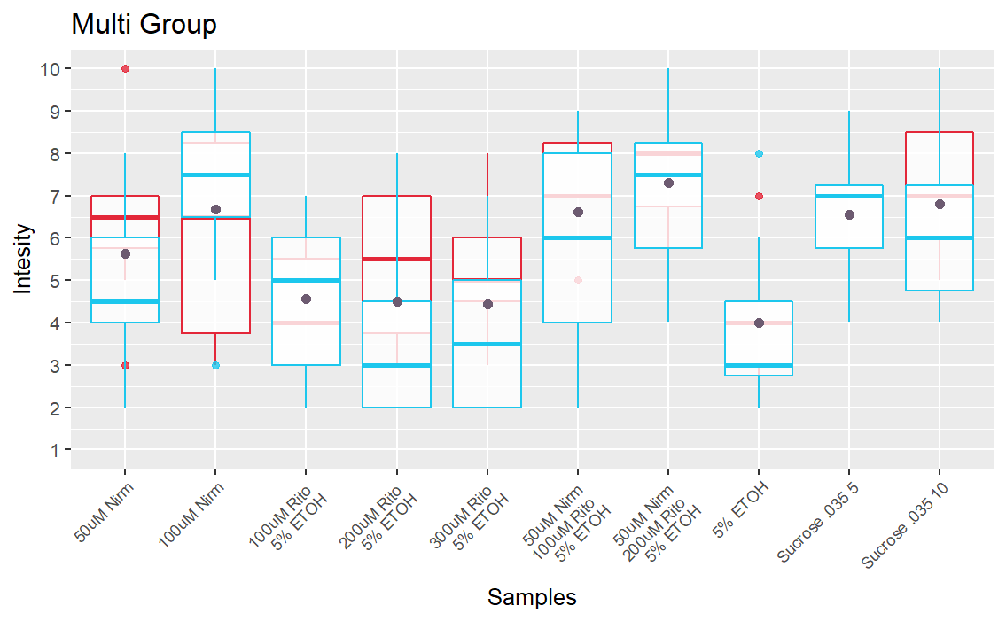
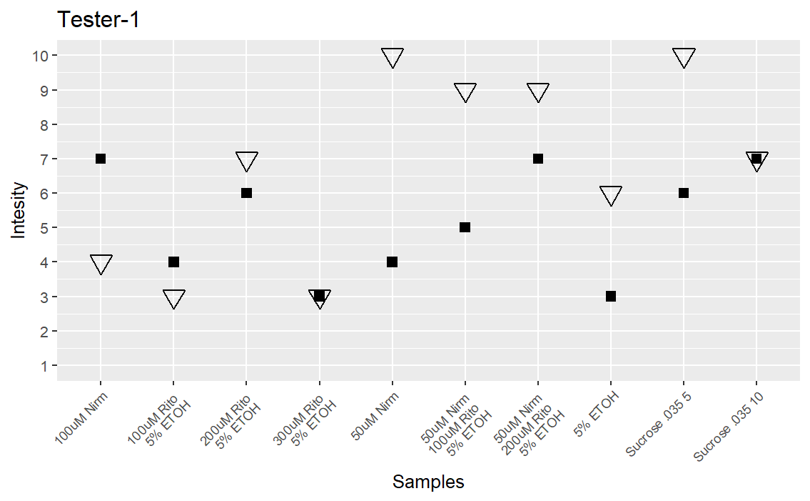
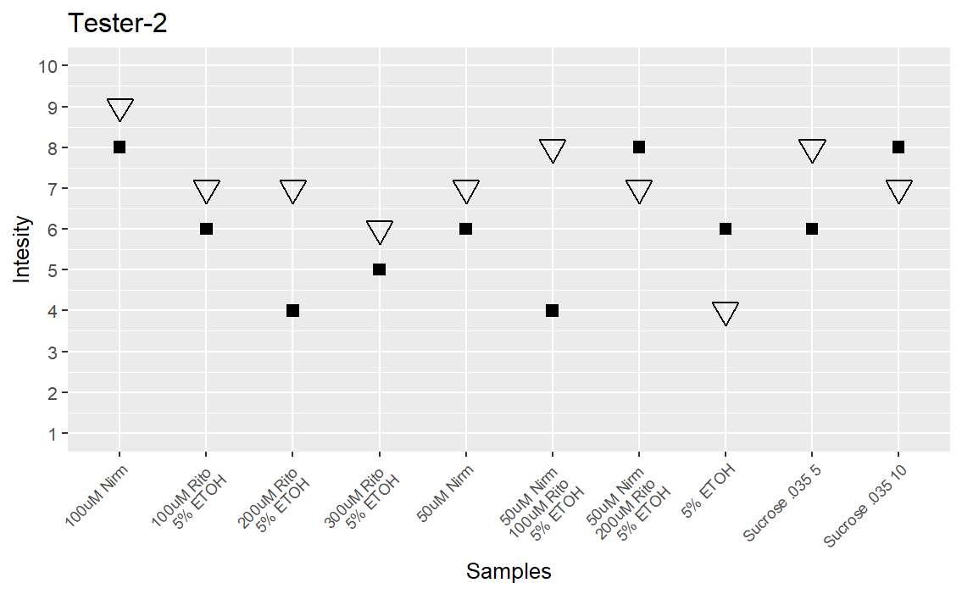
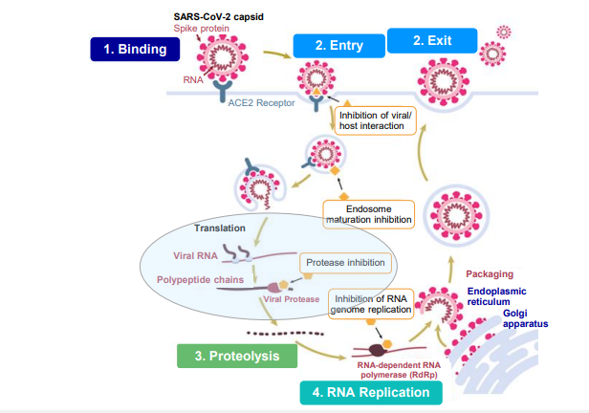
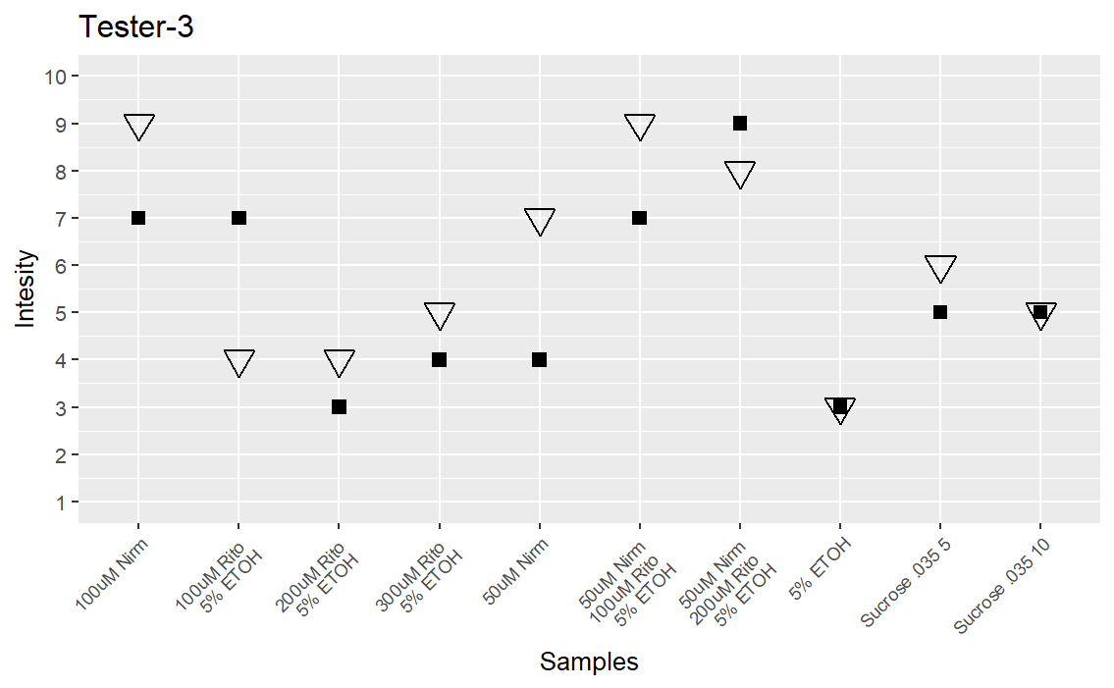
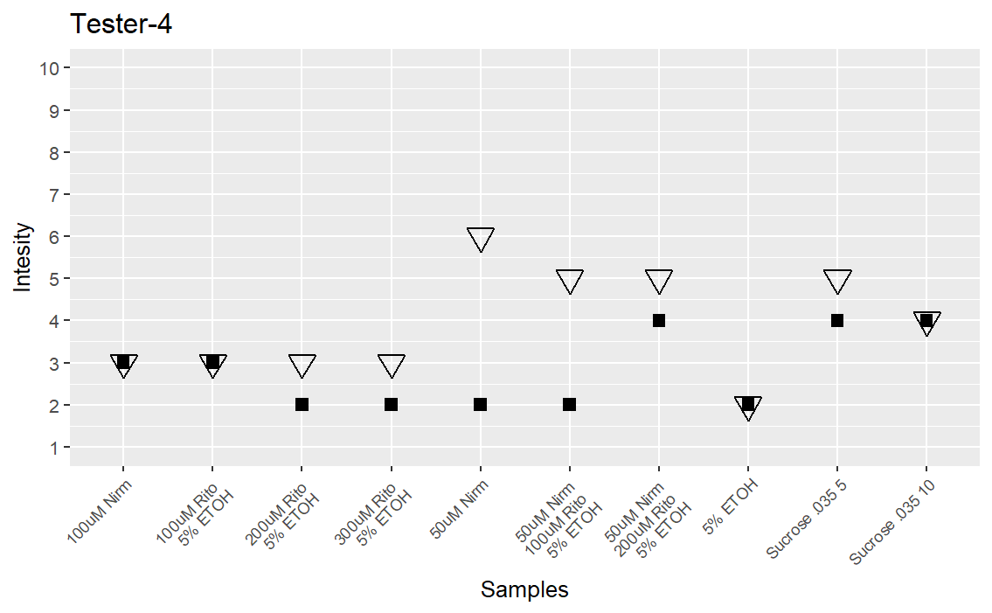
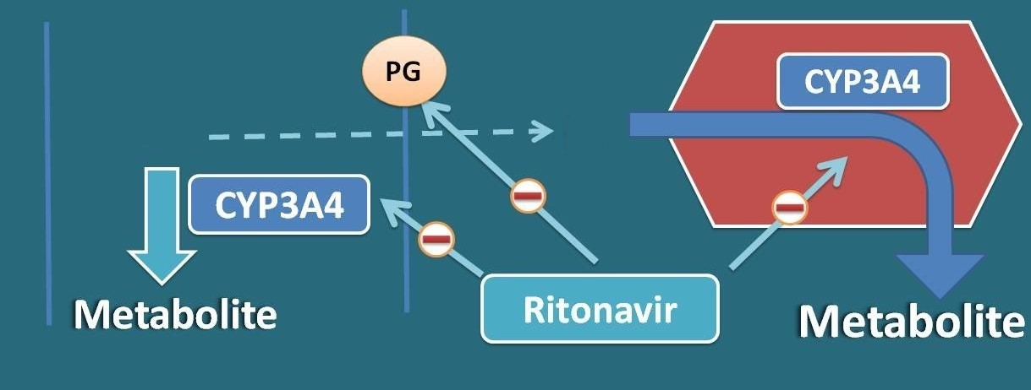
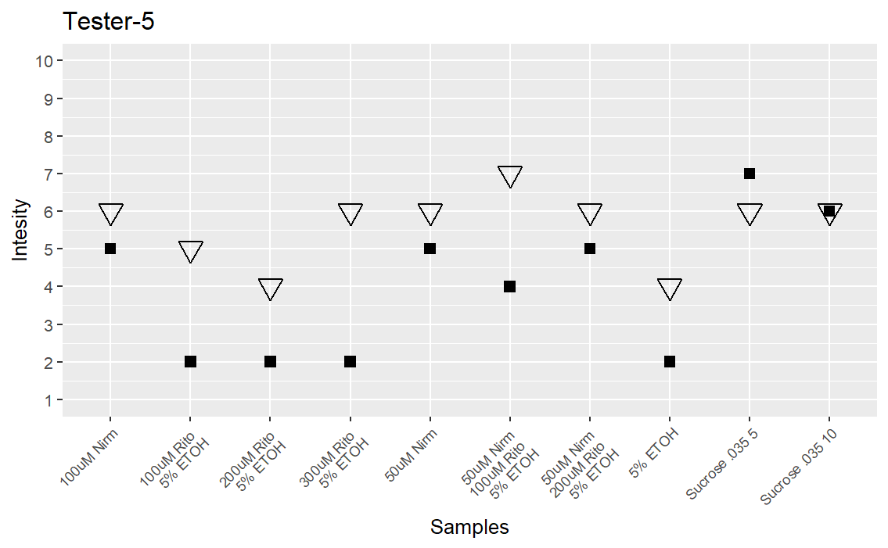
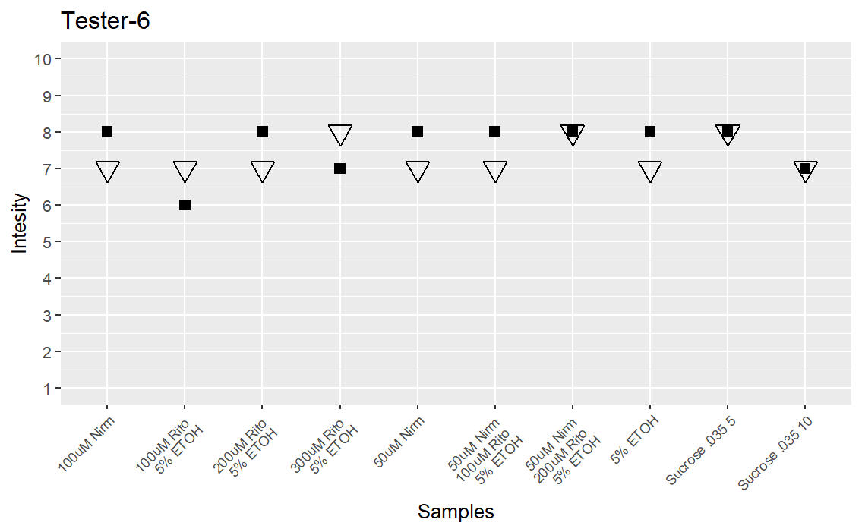
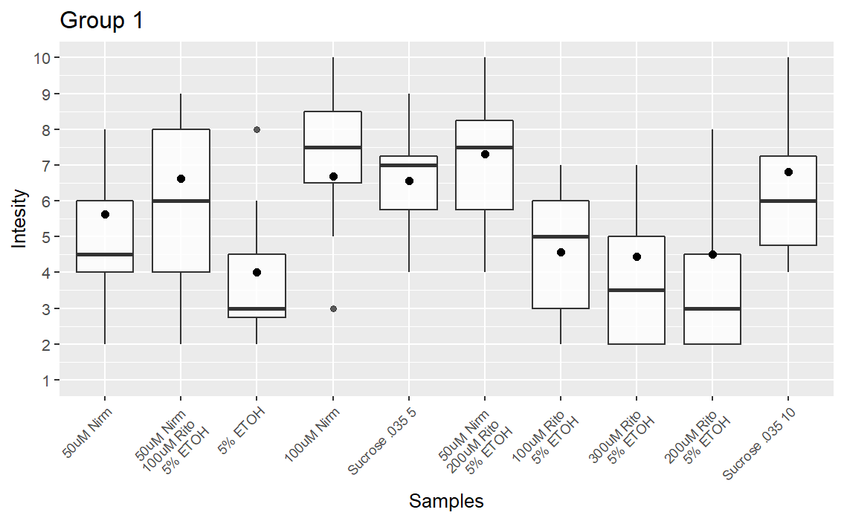
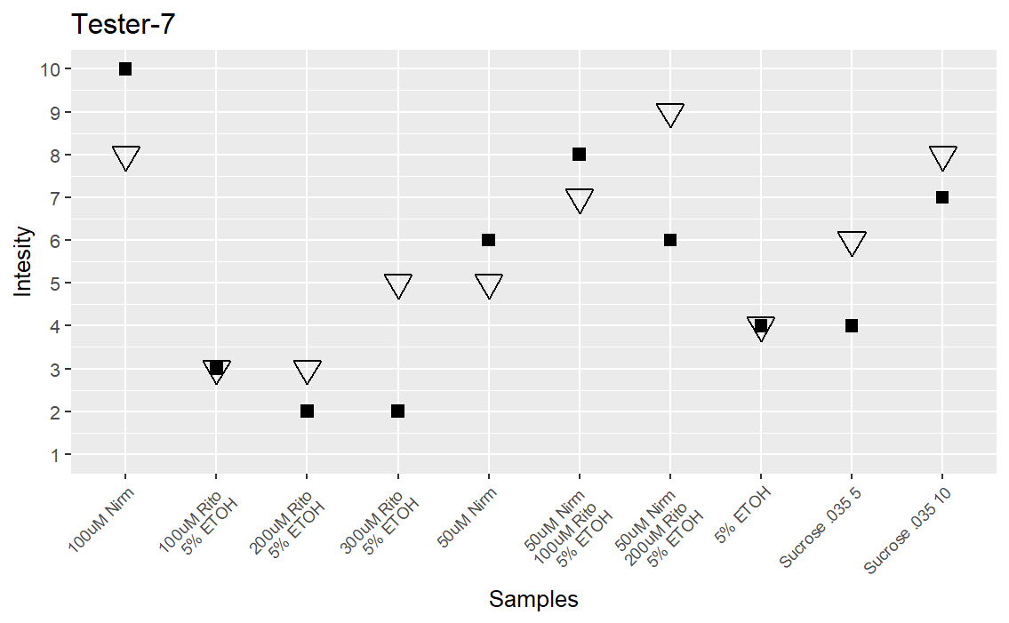
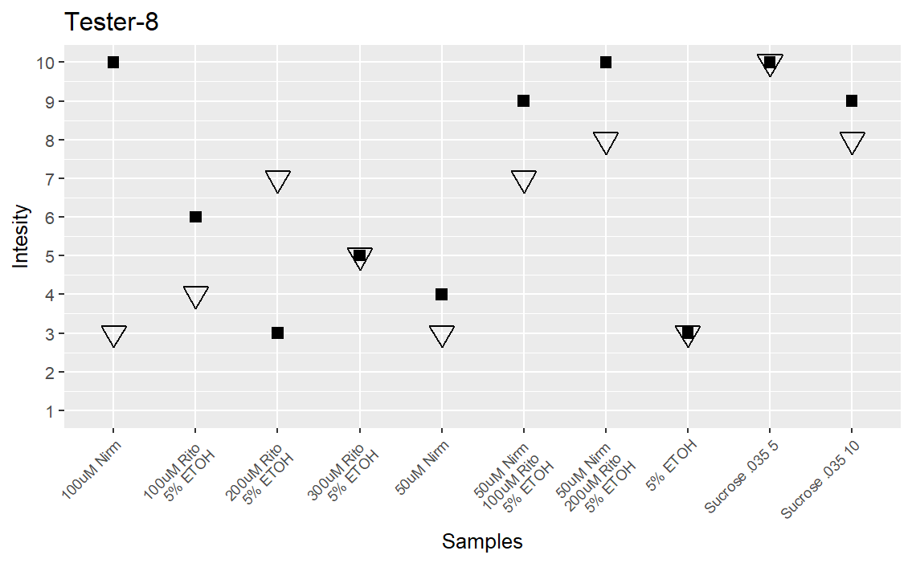
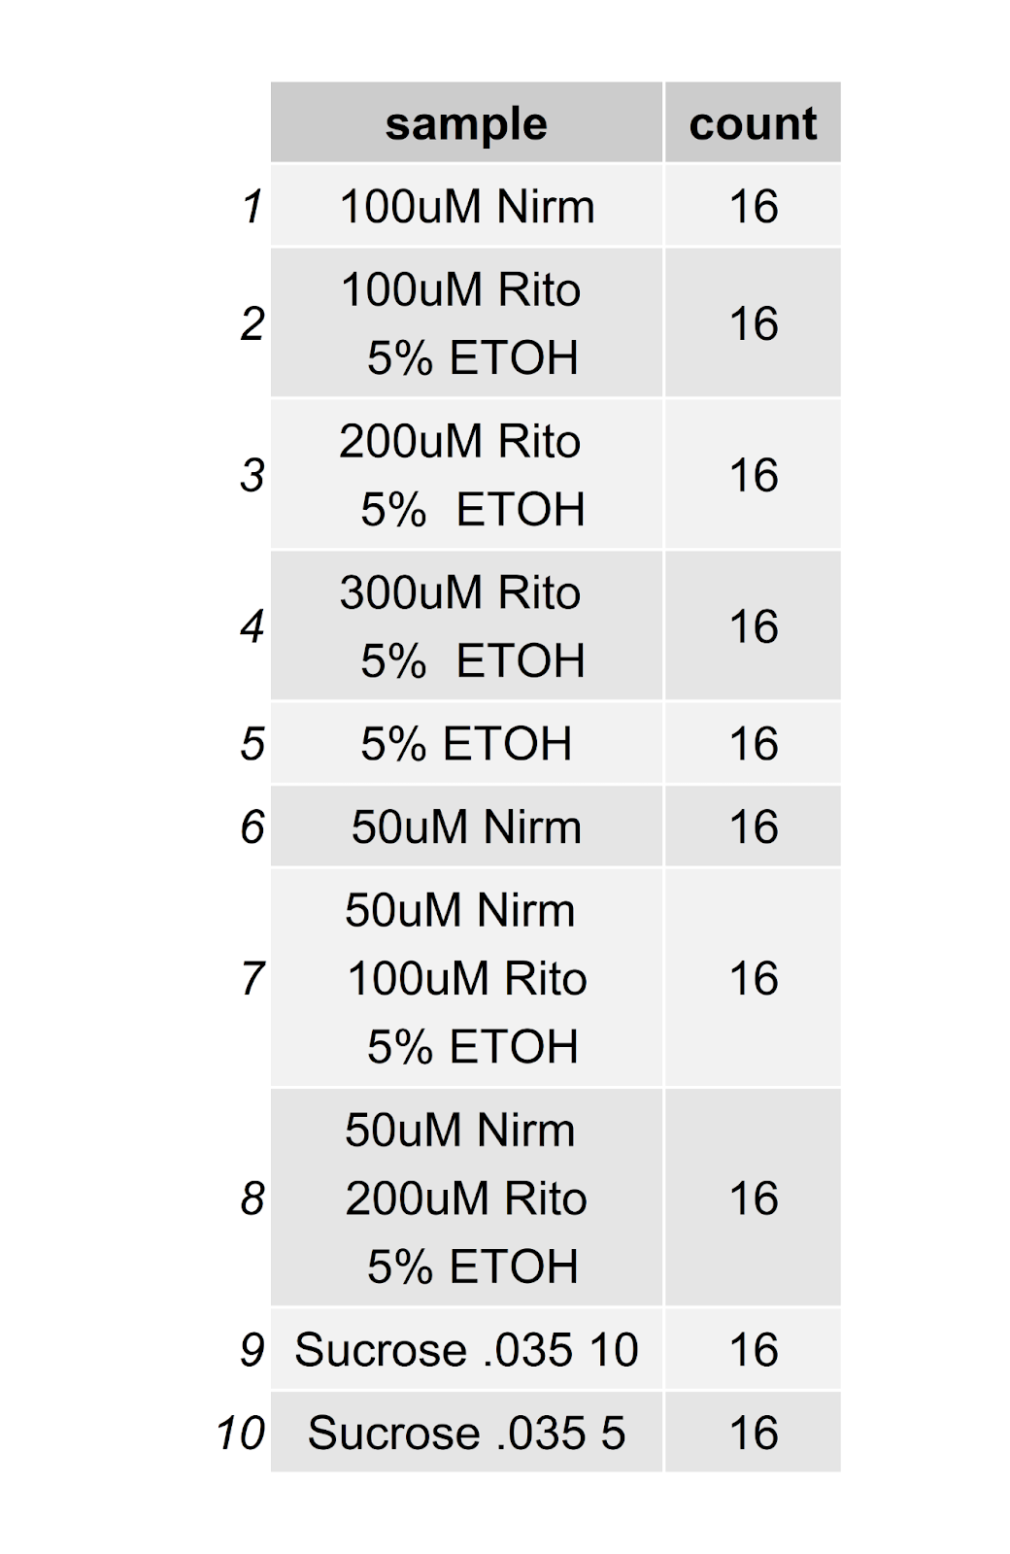
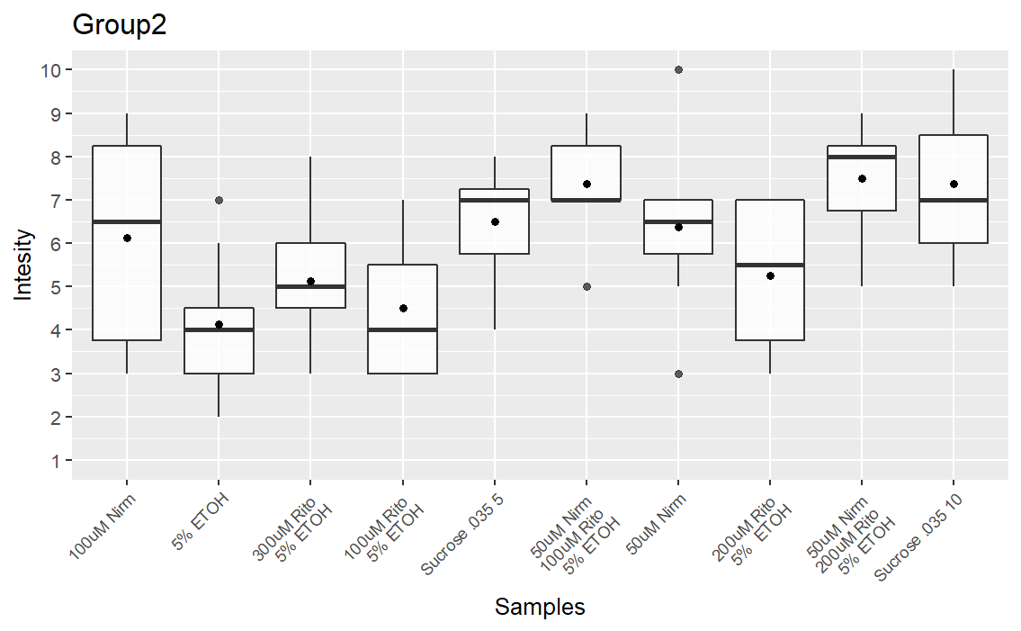
Introduction
Results: Group Intensity Ratings
Results: Individual Intensity Ratings
Covid-19 is a raspatory virus that started in 2019 and quickly spread to the rest of the world. Paxlovid is a medication taken over the course of five days twice a day to treat covid-19 and is made up of two drugs Nirmatrelvir and Ritonavir. It was the first oral medication to come out for covid-19. The reason we are looking into Paxlovid is because it has been shown to cause dysgeusia.
A
Graph A shows a combined boxplot of both groups one and two and the intensity ratings that were given to each solution. Order of solutions was altered between the two experiments.
B
B
Find if one or both medications are causing paxlovid dysgeusia.
Determining sensory properties of Ritonavir and Nirmatrelvir
Found different intensity tolerances between different participants
Graph B shows the intensity ratings during the first round of testing in the order we gave them
Aims
Methods: Taste-Intensity testing
We made solutions using both Ritonavir and Nirmatrelvir the two different medications that are packaged within paxlovid. We tested eight different participants twice both times with the same solutions but in different orders.
C
These graphs show how each of the participants rated each of the solutions by intensity during the first and the second taste tests. The subjects were tested twice to see if there was a correlation between the order of the samples with the intensity that was labeled.
Graph C shows the intensity ratings during the Second round of testing in the order we gave them
Discussion
It was decided to stick with 5% ethanol because at high enough percentages the Ethanol would more than likely hide or greatly change the taste of the solution. There was no correlation by the order people were testing the solutions and the intensity people were reporting. On average Nirmatrelvir solutions and solutions with both ritonavir and Nirmatrelvir had higher average and sum intensity's then other solutions. There was an average difference overall between each solution of 0.625 but some solutions by themselves had a higher difference with some being as high as an average of 1.50.
Nirm = Nirmatrelvir
Rito = Ritonavir
5%=5% Ethanol
A

